Slide 1
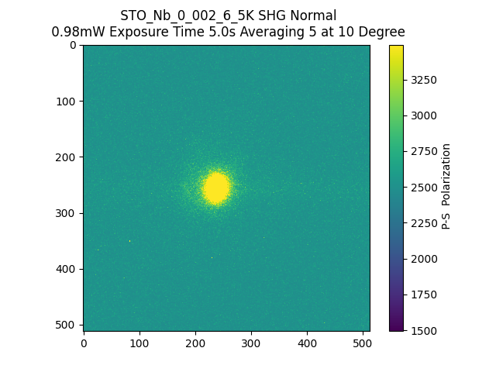
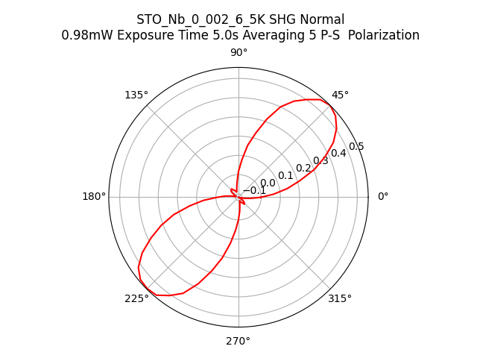
180953_STO_Nb_0_002_6_5K_SHG_Normal_PS

